Slide 1
Navigating Rapid Growth: Insights from a Bike-Share success story
How Cyclistic navigated strategic challenges during the competitive years 2022-2023
Michael Jordan
February 2026
Notes:
AI-generated content may be incorrect. --- This presentation explores the rapid growth of a bike sharing company, examining the challenges encountered and the strategies implemented to achieve sustainable success in a competitive industry.

Slide 2
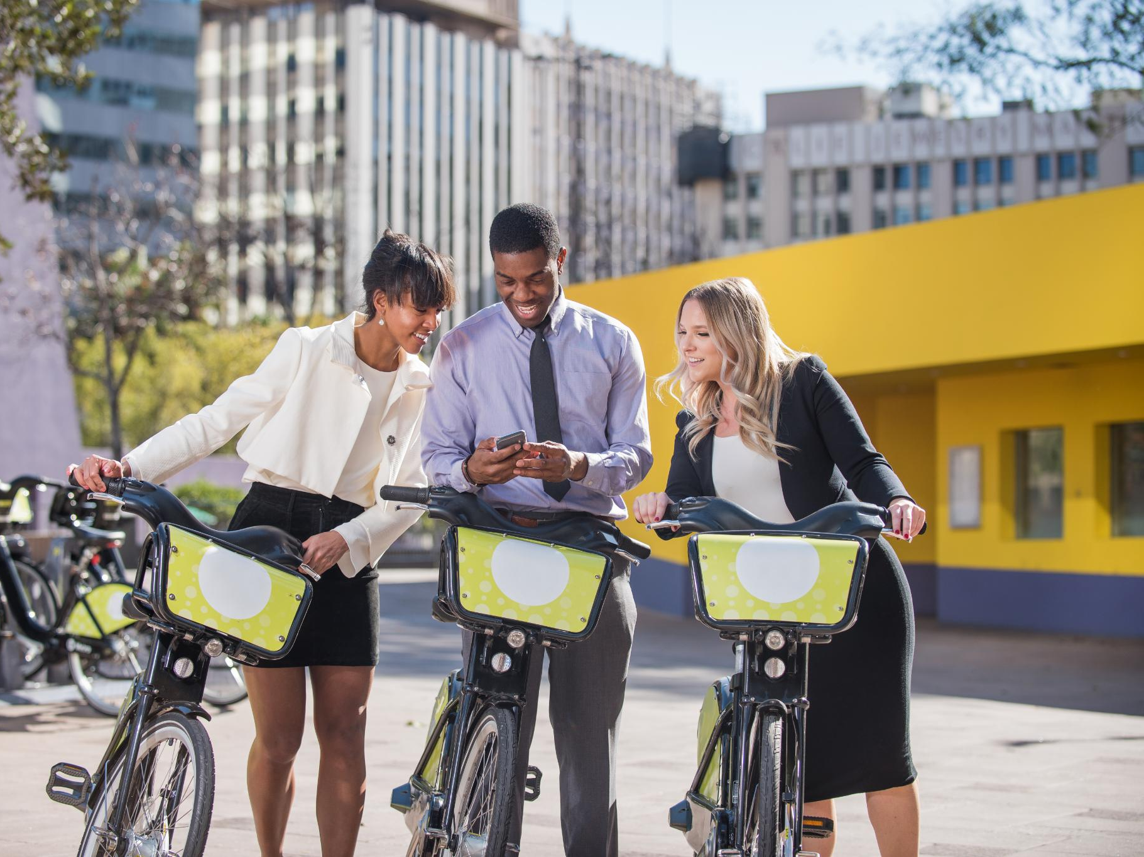
Introduction: How does a Bike Share company Navigate Speedy Success?
Rapid growth brings new pressure on operations and rider experience
A bike-share system can scale faster than its infrastructure, forcing teams to balance demand, maintenance, and reliability in real time.
Urban shifts reshape how riders move, commute, and rely on shared mobility
Cities evolve quickly, and bike-share programs must adapt to changing patterns without losing accessibility or consistency.
Understanding rider behavior is the key to smarter strategy and sustainable expansion
Turning usage patterns into action helps companies optimize stations, manage fleets, and grow membership with intention.
Notes:
The bike share industry has experienced significant growth due to urbanization, environmental concerns, and demand for accessible transportation. Understanding the market landscape helps contextualize the company's rapid rise.

Slide 3
Operational challenges and supporting evidence
Operational Strain on Fleet Availability
Problem Identified: Bikes frequently unavailable in high-demand zones
Analysis: Heat map review of station usage, supply-demand mismatch analysis.
Supporting Facts: Certain stations hit 95%depletion during peak hours.
Declining Member Retention
Problem Identified: Returning riders dropped despite overall growth.
Analysis: Member vs casual ride comparison, churn trend analysis.
Supporting Facts: Retention fell 12% during expansion.

Slide 4
PROBLEMS: CHALLENGES FACED DURING RAPID GROWTH (continued)
 | Uneven Geographic Growth Problem Identified: Some neighborhoods underutilized despite new stations. Analysis: Ride density mapping, demographic overlays, distance‑to‑station analysis. Supporting Facts: 30% of new stations saw <10 rides/day. Rising Maintenance Delays Problem Identified: Repairs lagged usage spikes. Analysis: Maintenance ticket review, turnaround‑time analysis. Supporting Facts: Average repair time increased from 1.8 to 3.2 days.

Slide 5

Solutions: Strategies Implemented to Overcome Challenges
Technology Integration
Alleviation: Implemented upgrade digital tools and automated systems to streamline operations and reduce manual errors
Alterative: considered outsourcing platform development to a third-party vendor
Maintenance Protocols
Alleviation: Established standardized inspection schedules and rapid-response repair workflows to minimize downtime
Alternative: Evaluate a full preventive-maintenance outsourcing model.
Customer Engagement
Alleviation: Enhanced communication channels and personalized messaging to improve rider satisfaction and retention
Alterative: Explored deploying an AI-based chatbot for 24/7 support
Operational Resource Scaling
Alleviation: Reallocated staff and bike inventory to high demand zones to balance load and improve service availability
Alternative: Considered short-term contractor staffing and temporary fleet expansion

Slide 6

Conclusion: Key Takeaways From the Case Study
Proactive Problem-Solving
Early identification of operational issues enabled teams to address challenges before they escalated
Collaborative discussions (mirrored by the figures in the gears) accelerated root-cause analysis
Leveraging Technology
Integrated digital tools acted as the “mechanical system” that kept operations aligned and efficient
Automation and real-time insights reduced manual workload and improved decision making
Customer Focus
Prioritizing rider needs ensured operational improvements translated into better customer experiences
Clear communication and responsive support strengthened satisfaction and long-term loyalty.
Adaptable Strategies
Flexible resource allocation allowed Cyclistic to adjust to shifting demand patterns
Evaluating multiple solution paths encouraged innovation and organizational resilience

Slide 7

Next Steps: Recommendations for Sustainable Success
Continuous Innovation
Ongoing innovation is key to adapting and growing in the dynamic bike share industry.
Investment in Infrastructure
Investing in bike lanes and docking stations enhances user experience and accessibility.
Strengthening Partnerships
Collaborating with stakeholders fosters growth and sustainable business models.
Ongoing Evaluation
Regular assessment ensures alignment with sustainability goals and market demands.
Notes:
Recommendations include continuous innovation, investment in infrastructure, strengthening partnerships, and ongoing evaluation to ensure long-term sustainability and growth in the evolving bike share industry.

Slide 8
Next SteP - READ ME
What Needs to Be Done
Implement an upgraded digital operations platform to centralize bike availability, maintenance tracking, and customer insights
Automate routine workflows such as repair scheduling, inventory updates, and demand forecasting
Integrate real‑time data dashboards to support faster decision‑making across teams
Who Should Enforce It
Director of Operations — oversees implementation and ensures alignment with business goals
IT Systems Manager — leads platform integration, automation setup, and data migration
Maintenance and Customer Service Leads — adopt new tools and provide feedback for continuous improvement
When It Should Happen
Weeks 1–2: Finalize platform selection and integration requirements
Weeks 3–6: Begin phased rollout of automation and dashboard tools
Weeks 7–10: Train staff, refine workflows, and monitor early performance
Ongoing: Evaluate system performance and adjust based on operational data
Notes:
In summary, navigating rapid growth requires addressing challenges head-on with strategic solutions. This case study illustrates how a bike share company successfully managed expansion while laying the foundation for sustainable success.

Slide 9
NEXT Step-Read Me con’t
Why This Choice Creates a Positive Impact
Improves operational efficiency by reducing manual workload and errors
Strengthens customer experience through faster response times and better communication
Supports scalability as demand fluctuates across seasons and neighborhoods
Enables proactive problem‑solving by giving teams real‑time visibility into issues
Creates alignment across operations, maintenance, and customer engagement
Data‑driven action sets Cyclistic up for smarter operations, better service, and long‑term success

